Slide 1
Principles of electrical science
Basic mechanics, Power and Efficiency

Slide 2
Basic mechanics
Mass
Mass can be defined as the amount of matter in an object. The SI unit of mass is the kilogram (kg).
Acceleration
When an aircraft takes off, it starts from rest and increases its velocity until it can fly. This change in velocity is called acceleration. Acceleration is the change in velocity with time.
Acceleration | = | final velocity (v) - initial velocity(u) | (m/s²)
 |  | Time

Slide 3
Basic mechanics
Example 1
If a car accelerates from a velocity of 3m/s to 15m/s in four seconds, calculate its average acceleration.
Average velocity | = | $$\frac{v −u}{t}m/s$$
Average acceleration | = | $$\frac{15 −3}{4}$$
Average acceleration | = | 12
 |  | 4
 | = | 3m/s²
Thus, the average acceleration is three metres per second, every second.

Slide 4
Basic mechanics
Force
The SI unit of force is the Newton (N).
A mass of 1kg experiences a force of 9.81 Newtons as a result of gravity. In other words, it would require a force of 9.81 Newtons to raise a mass of 1kg against the pull of gravity (on Earth).
To calculate the force on a body due to gravity (on Earth) multiply its mass by 9.81.

Slide 5
Basic mechanics
Example 2
A bundle of conduit has a mass of 800kg. What force will be required to lift it?
Force required | = | Mass × Acceleration due to gravity
 | = | 800 × 9.81
 | = | 7,848 Newtons

Slide 6
Basic mechanics
Work done
Force is measured in Newtons
Work done is measured in Newton metres (Nm)

Slide 7
Basic mechanics
Example 3
What work must be done to lift a 200kg bundle of conduit from the floor on to a rack 2m high?
Work done | = | Force x distance
 | = | 200 × 9.81 × 2
 | = | 3,924 Nm

Slide 8
Basic mechanics
Energy
Energy is the capacity for doing work. It may exist in potential, kinetic, thermal, electrical, chemical, nuclear, or other various forms.
The unit of energy is the Newton metre, or Joule.
Work or work done | = | Energy
 | = | Force x Distance
 | = | Joules

Slide 9
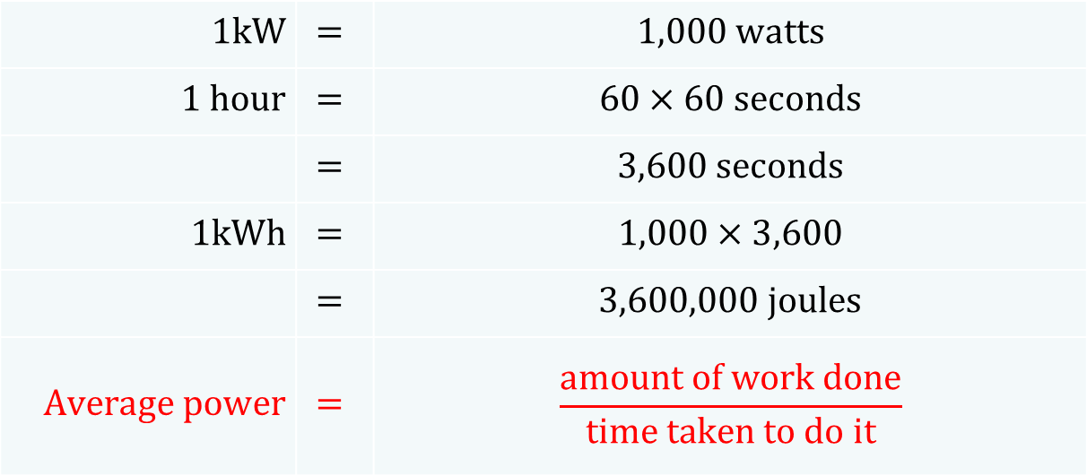
Basic mechanics
Power
Power is defined as the rate of doing work.
The unit of Power is the watt. Since the watt is a small unit, the kilowatt (kW) is often used.
$$1kW$$ | $$=$$ | $$1,000 watts$$
$$1 hour$$ | $$=$$ | $$60×60 seconds$$
 | $$=$$ | $$3,600 seconds$$
$$1kWh$$ | $$=$$ | $$1,000×3,600$$
 | $$=$$ | $$3,600,000 joules$$
$$Average power$$ | $$=$$ | $$\frac{amount of work done}{time taken to do it}$$

Slide 10
Basic mechanics
Efficiency
The efficiency of a system can be defined as the ratio of output power to input power. It is usually expressed as a percentage.
Output | = | Input − Losses
Input | = | Output + Losses

Slide 11
Basic mechanics
Example 4
A motor produces 100 watts output power and is:
50% efficient
70% efficient.
Calculate its input power in each case.
Efficiency | = | Output power | × 100
 |  | Input power
Input power | = | Output power | × 100
 |  | Efficiency
Input power | = | 100 | × 100
 |  | 50
a)
 | = | 200 watts

Slide 12
Basic mechanics
b)
Input power | = | Output power | × 100
 |  | Efficiency
Input power | = | 100 | × 100
 |  | 70
= | 142.86 watts

Slide 13
Basic mechanics
Example 5
An electric motor drives a pump that lifts 1,000 litres of water each minute to a tank 20 metres above ground level. Calculate the power that the motor must provide if the pump is only:
50% efficient
80% efficient.
Work | = | Force × distance
Force | = | Mass in kg × 9.81
NB: One litre of water weighs 1kg (1kg = 9.81N)
 | = | 1,000 × 9.81 × 20
 | = | 196,200Nm/minute or joules
Joules | = | Watts × seconds
Watts | = | Joules
 |  | seconds
= | 196,200
 | 60
= | 3,270 Watts (output power)

Slide 14
Basic mechanics
Efficiency | = | Output power | × 100
 |  | Input power
Input power | = | Output power | × 100
 |  | Efficiency
a)
Input power | = | 3,270 | × 100
 |  | 50
 | = | 6,540 watts

Slide 15
Basic mechanics
Input power | = | Output power | × 100
 |  | Efficiency
b)
Input power | = | 3,270 | × 100
 |  | 80
= | 4,087.5 watts

Slide 16
Principles of electrical science
The end

